Slide 1

Introduction to Deep Learning Applications and Theory
Week 8
Lecture 24
ECE 596 / AMATH 563

Slide 2
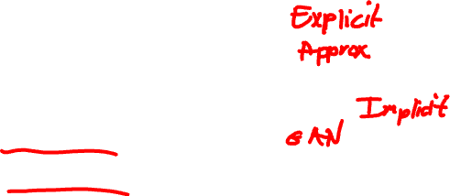
Previous Lecture:
Generative Models and Adversaries
Variational AutoEncoder
Generative Adversarial Models
Generator
Discriminator

Slide 3

This Lecture:
Generative Models and Adversaries
GAN Optimization
GAN Applications

Slide 4
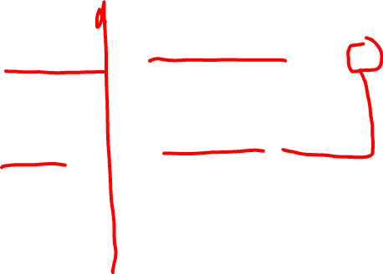
GAN
D(G(z))
“Cost”: $\left\|D(G(z))\right\|$
Discriminator NN
(D)
x
Generator NN
(G)
“Cost”: $\left\|D\left(G\left(z\right)\right)−1\right\|$
z

Slide 5
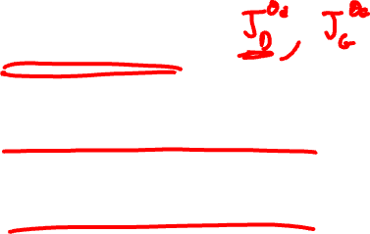
Questions
How would you formulate training of such a network as an optimization problem.
What’s the cost?
How would you optimize it?
What is the desired solution?

Slide 6
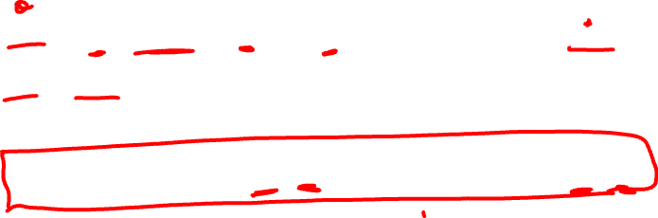
Competing Cost Functions
$J^{(D)}=−\frac{1}{2}𝔼_{x\sim p_{data}}\log{D_{θ_{d}}\left(x\right)}−\frac{1}{2}𝔼_{z\sim p_{model}}\log\left(1−{D_{θ_{d}}(G}_{θ_{g}}\left(z\right))\right)$
$J^{(G)}=−J^{(D)}$
$J^{(D)}=−\frac{1}{2}\int{p_{data}\left(x\right)\log{D\left(x\right)dx}}−\frac{1}{2}\int{p_{model}\left(x\right)}\log\left(1−D\left(x\right)\right)dx$

Slide 7
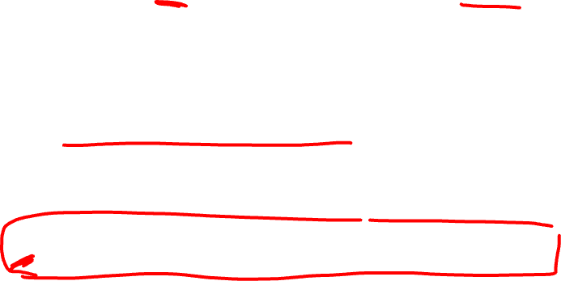
Question 2
Instead of $θ_{d}$ assume that we optimize $D(x)$ for every value of $x$. What would be the optimal strategy for $D(x)$ ?
What assumptions are needed?
$J^{(D)}=−\frac{1}{2}\int{p_{data}\left(x\right)\log{D\left(x\right)dx}}−\frac{1}{2}\int{p_{model}\left(x\right)}\log\left(1−D\left(x\right)\right)dx$

Slide 8
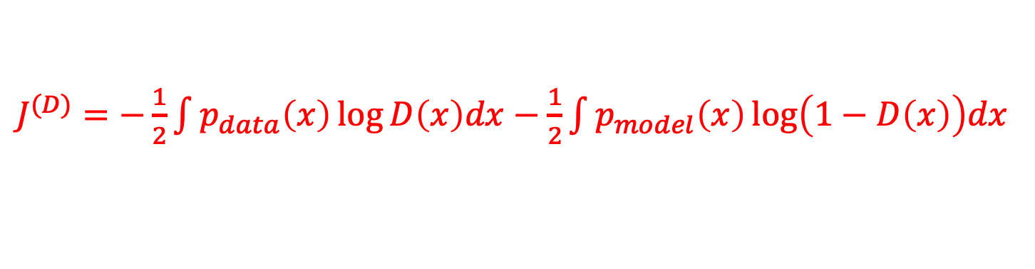
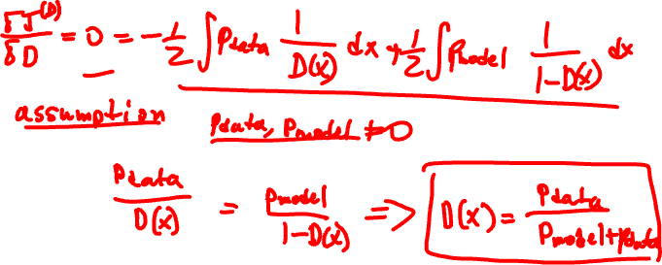
Solution
$J^{(D)}=−\frac{1}{2}\int{p_{data}\left(x\right)\log{D\left(x\right)dx}}−\frac{1}{2}\int{p_{model}\left(x\right)}\log\left(1−D\left(x\right)\right)dx$

Slide 9
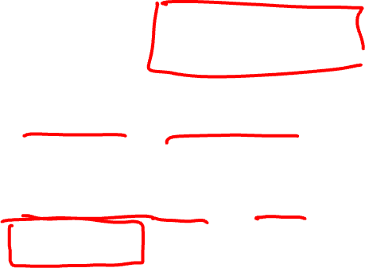
Solution
Optimal $D(x)$ is
$$D(x)=\frac{p_{data}}{p_{model}+p_{data}}$$
Assumption: $p_{model}, p_{data}$ are nonzero everywhere
Equilibrium: $p_{model}=p_{data}$ then $D(x)=\frac{1}{2}$

Slide 10
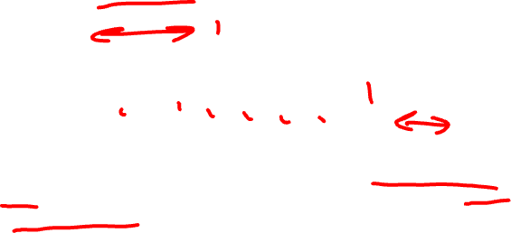
Unsupervised -> Supervised
Data
Discriminator
Model
In GANs, the fact that the discriminator learns an approximation of the
ratio p_{data}(x)/p_{model}(x) is the key insight that allows it to work and makes
it distinctly different from other generative models that learn p_{model} (x) directly
(or indirectly via latent variable models).

Slide 11
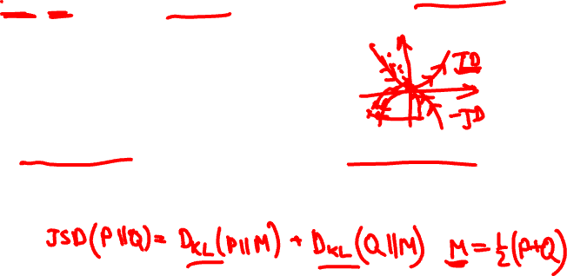
Minimax Game Optimization
$$\min_{θ_{g}}{\max_{θ_{d}}\left[𝔼_{x\sim p_{data}}\log{D_{θ_{d}}(x)}+𝔼_{z\sim p_{model}}\log{(1−{D_{θ_{d}}(G}_{θ_{g}}\left(z\right)))}\right]}$$
Discriminator output
for real data
Discriminator output
for generated data
Solution:
Saddle point in the parameter space (Nash Equillibrium)
Similar to solution of Jensen-Shannon Divergence

Slide 12
Question 3
How would a pseudo code for GAN training look like?
Can you think of some variations?

Slide 13
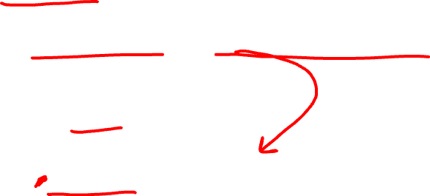
Optimization
Gradient ascent for the discriminator on J
$J^{(D)}=\frac{1}{2}𝔼_{x\sim p_{data}}\log{D_{θ_{d}}\left(x\right)}+\frac{1}{2}𝔼_{z\sim p_{model}}\log\left(1−{D_{θ_{d}}(G}_{θ_{g}}\left(z\right))\right)$
$$\underset{θ_{d}}{θ_{d}← arg min}{J^{(D)}}$$
Gradient descent for the generator
$$J^{(G)}=−\frac{1}{2}𝔼_{z\sim p_{model}}\log\left(1−{D_{θ_{d}}(G}_{θ_{g}}\left(z\right))\right)$$
$$\underset{θ_{g}}{θ_{g}← arg min}{J^{(G)}}$$

Slide 14
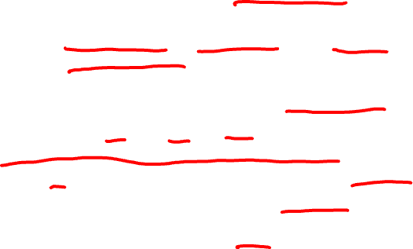
Solution
Take k gradient steps for the discriminator (k a hyperparameter), each doing the following:
Sample m noise samples, {z⁽¹⁾,z⁽²⁾,...,z^{(m)}} from p_{model}(z).
Sample m actual samples, {x⁽¹⁾,x⁽²⁾,...,x^{(m)}} from p_{data}(x): (a minibatch of your input data.)
Perform an optimization step on the discriminator:
Do gradient descent step for the generator:
Sample m noise samples, {z⁽¹⁾,z⁽²⁾,...,z^{(m)}} from p_{model}(z).
Perform an optimization step on the generator:
$$θ_{d}^{n+1}=θ_{d}^{n}+α∇J^{\left(D\right)}$$
$$θ_{g}^{n+1}=θ_{g}^{n}+α∇J^{\left(G\right)}$$

Slide 15
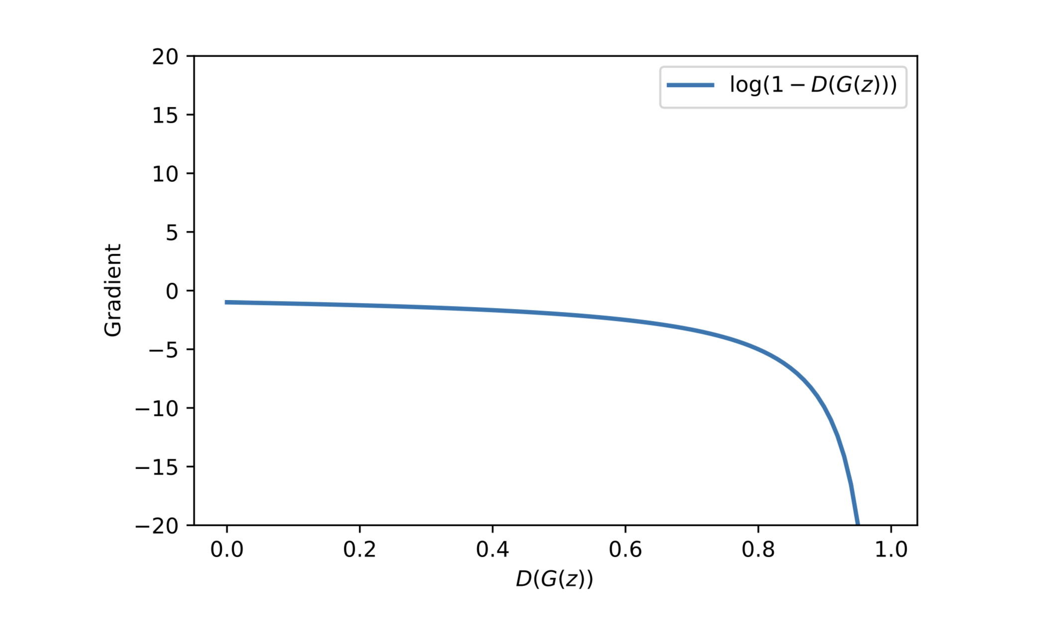

Saturation
The gradient of log(1 − D(G(z))) is:
Loss is probably fake

Slide 16
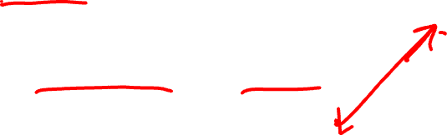
Non Symmetric Optimization
Gradient “ascent” for the discriminator on J
$J^{(D)}=\frac{1}{2}𝔼_{x\sim p_{data}}\log{D_{θ_{d}}\left(x\right)}+\frac{1}{2}𝔼_{z\sim p_{model}}\log\left(1−{D_{θ_{d}}(G}_{θ_{g}}\left(z\right))\right)$
$$\underset{θ_{d}}{θ_{d}← arg min}{J^{(D)}}$$
Gradient “ascent” for the generator
$$J^{(G)}=\frac{1}{2}𝔼_{z\sim p_{model}}\log\left({D_{θ_{d}}(G}_{θ_{g}}\left(z\right))\right)$$
$$\underset{θ_{g}}{θ_{g}← arg min}{J^{(G)}}$$

Slide 17
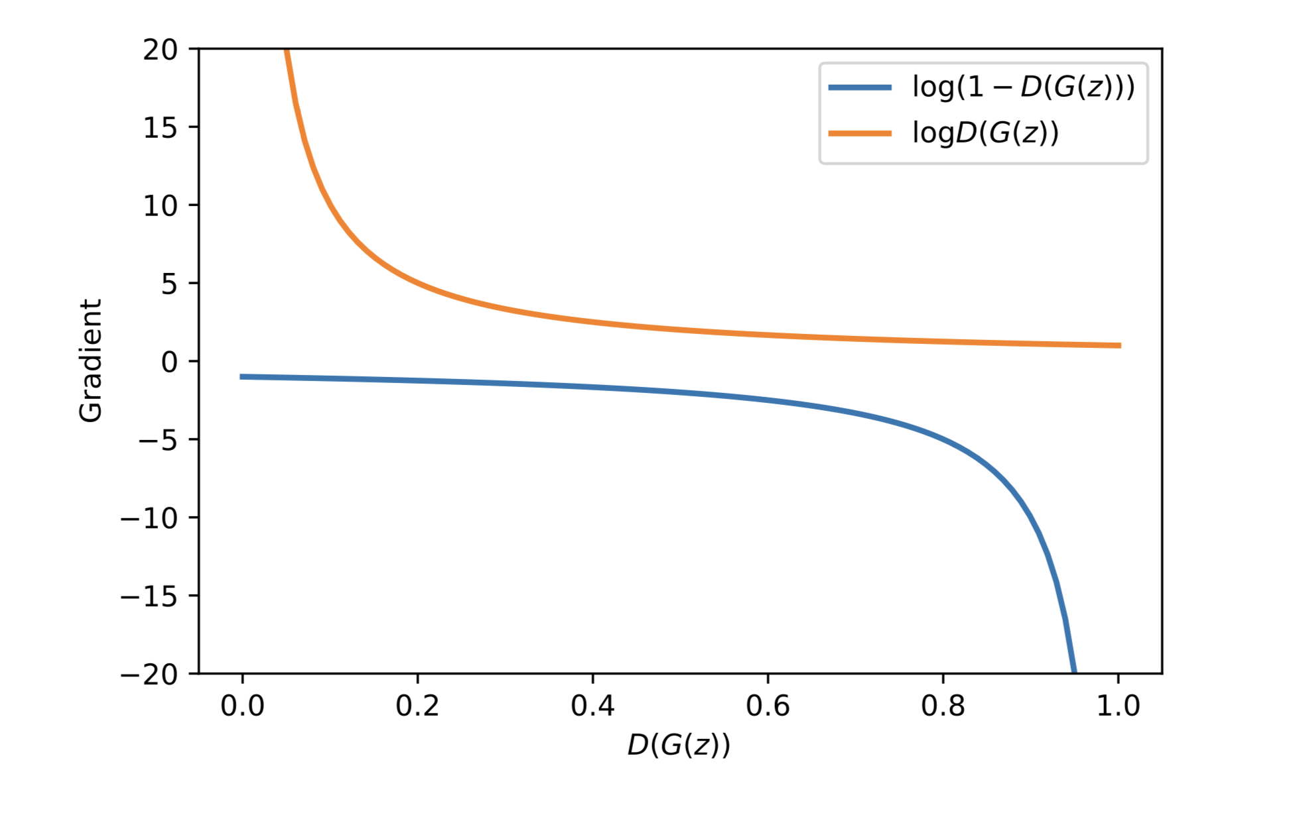
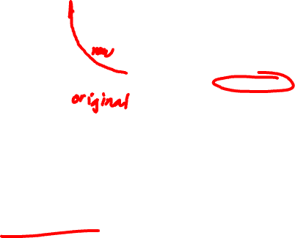
Non Saturating Training
Note that by changing the cost function for the generator network,
the game is no longer zero-sum. This is a heuristic change made to the game to
solve the practical problem of saturating gradients when the generator isn’t
doing well.

Slide 18
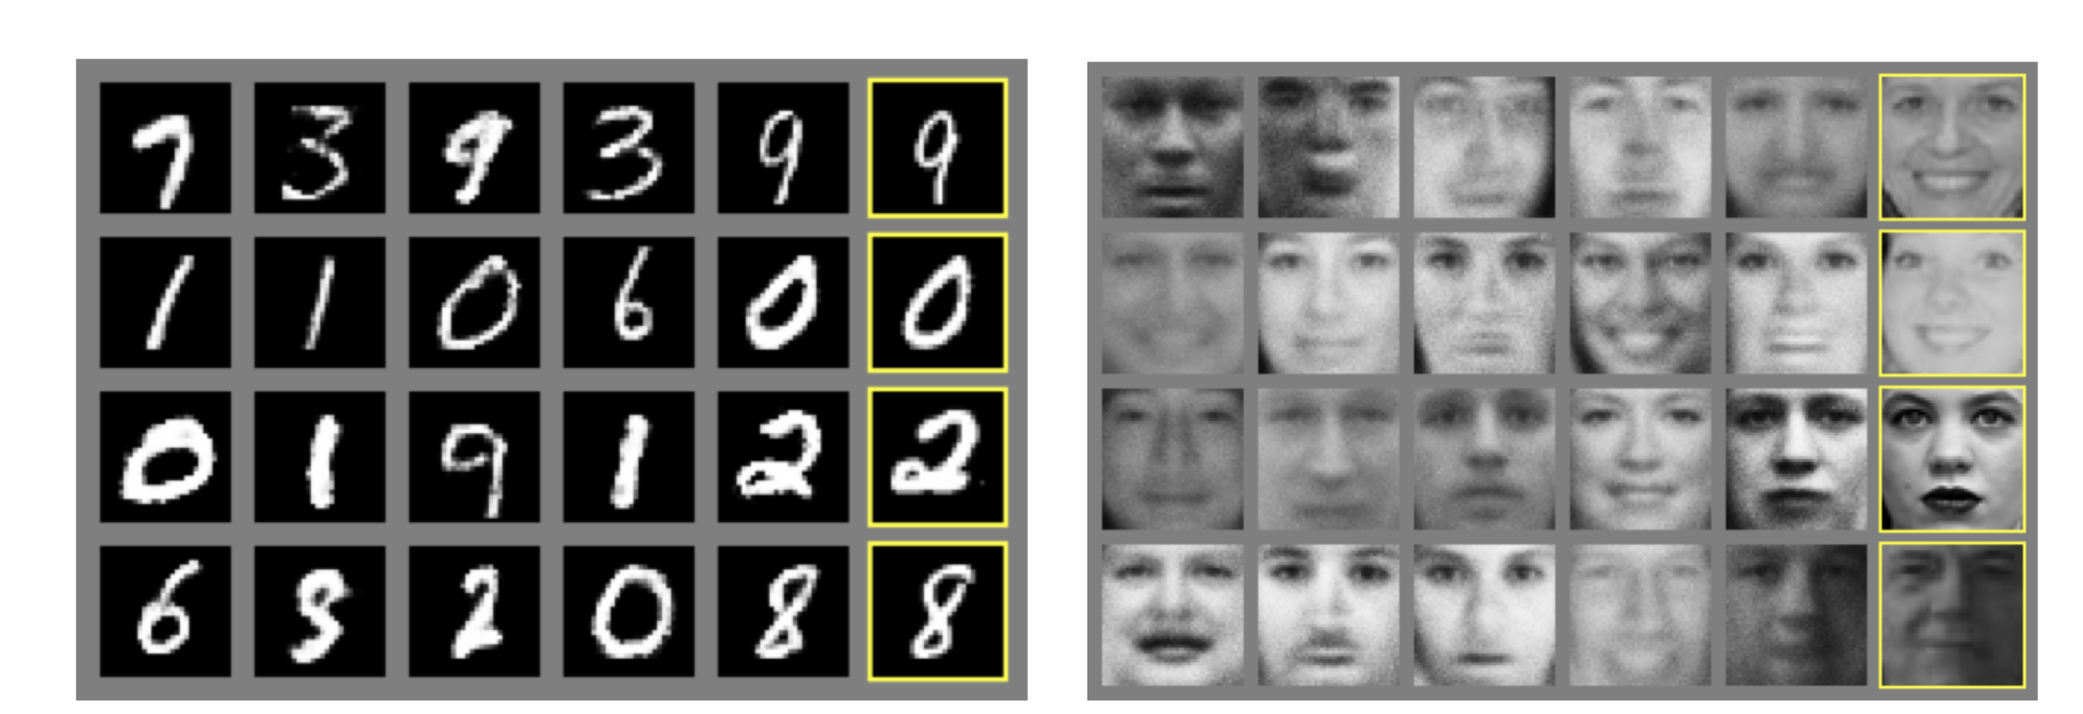
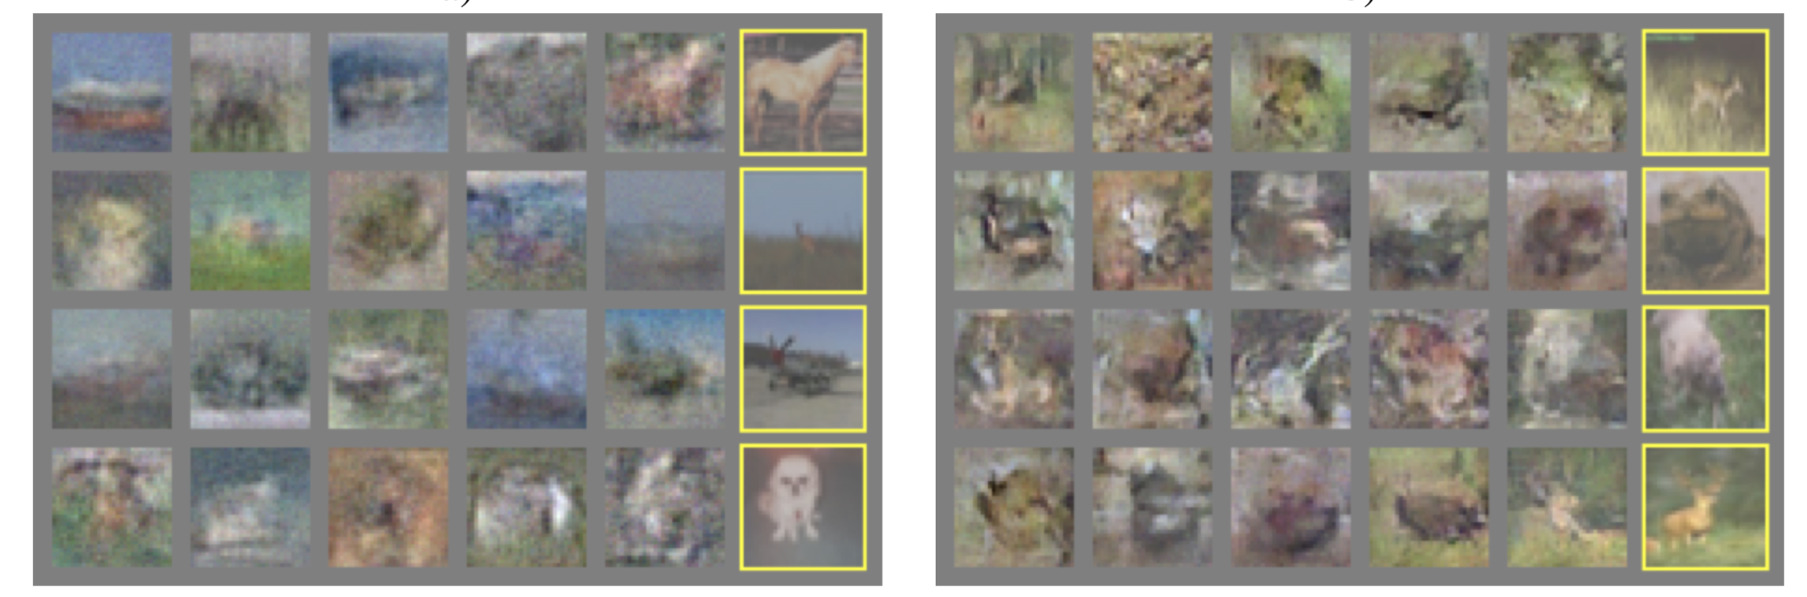
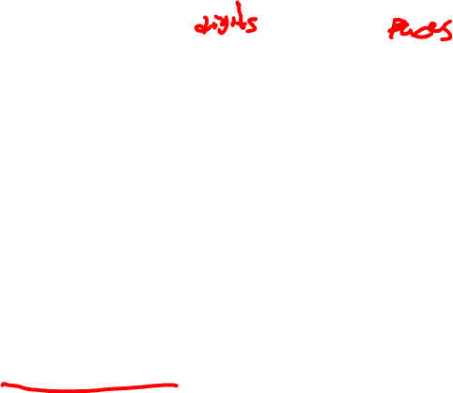
Generating Images
Goodfellow et al. (2014) Generative Adversarial Nets

Slide 19
DCGAN
Radford, Alec, Luke Metz, and Soumith Chintala. "Unsupervised representation learning with deep convolutional generative adversarial networks." (2015).

Slide 20
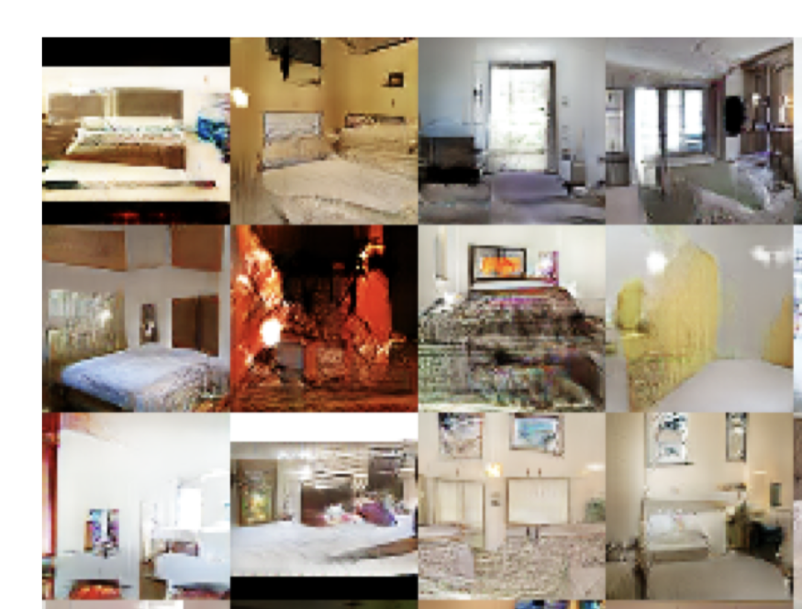
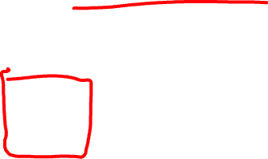
LSUN Bedrooms

Slide 21
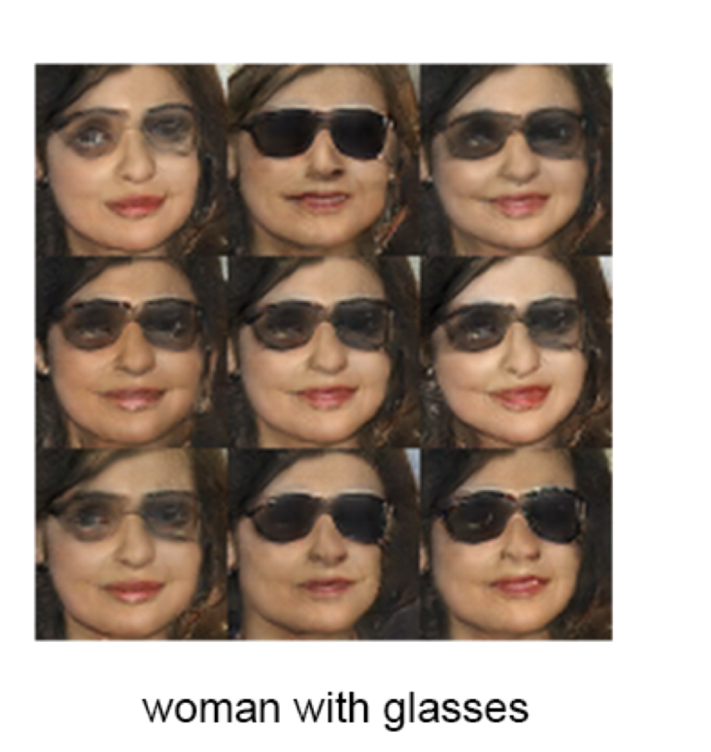
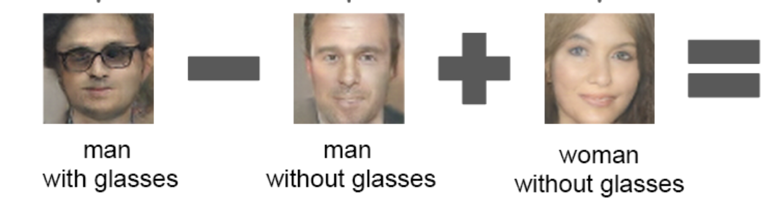
Similarity in Hidden Space

Slide 22
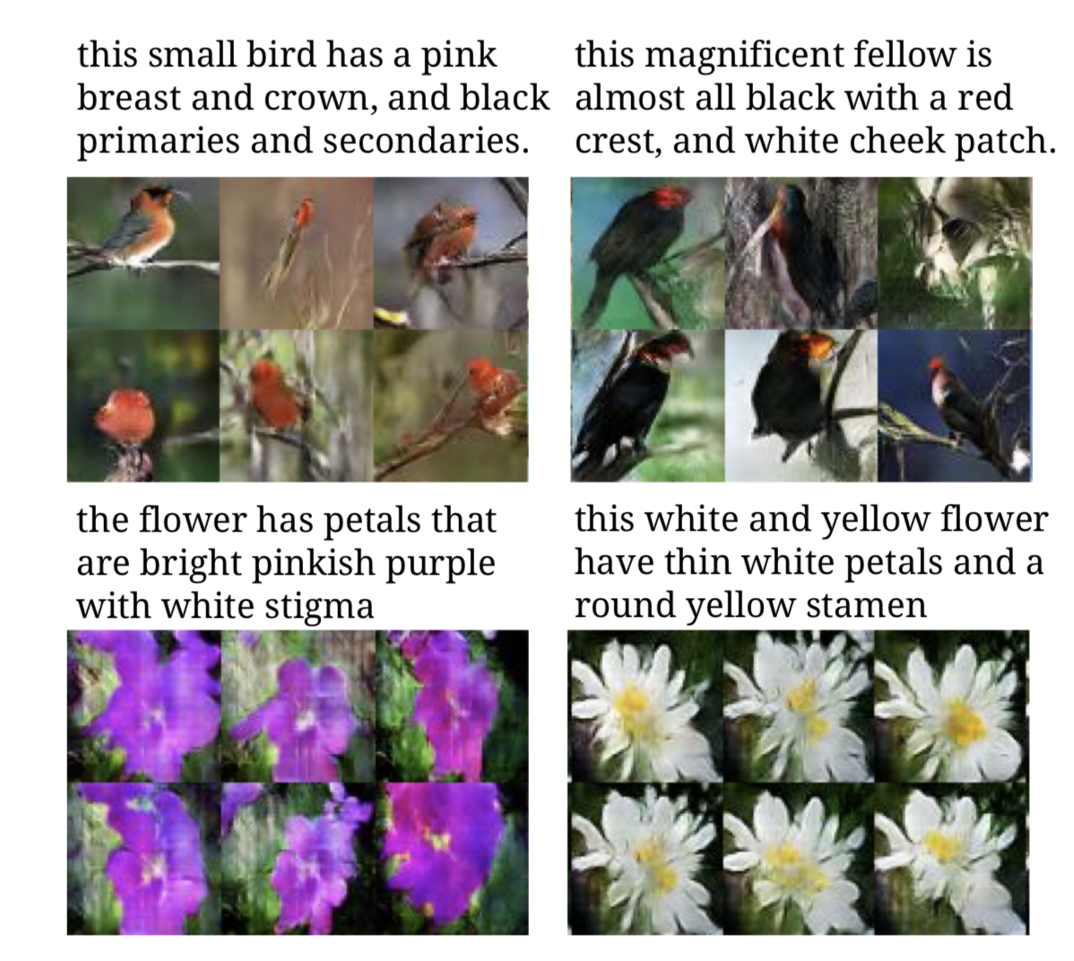
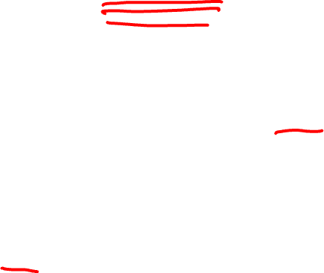
Text -> Image Synthesis
Reed et al. Generative Adversarial Text to Image Synthesis (2017)

Slide 23
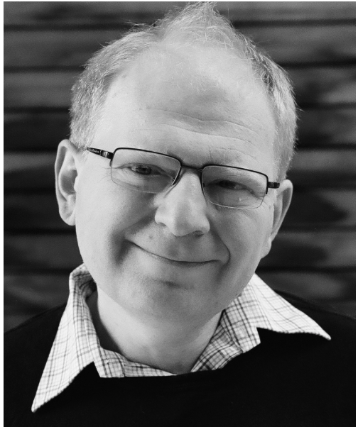
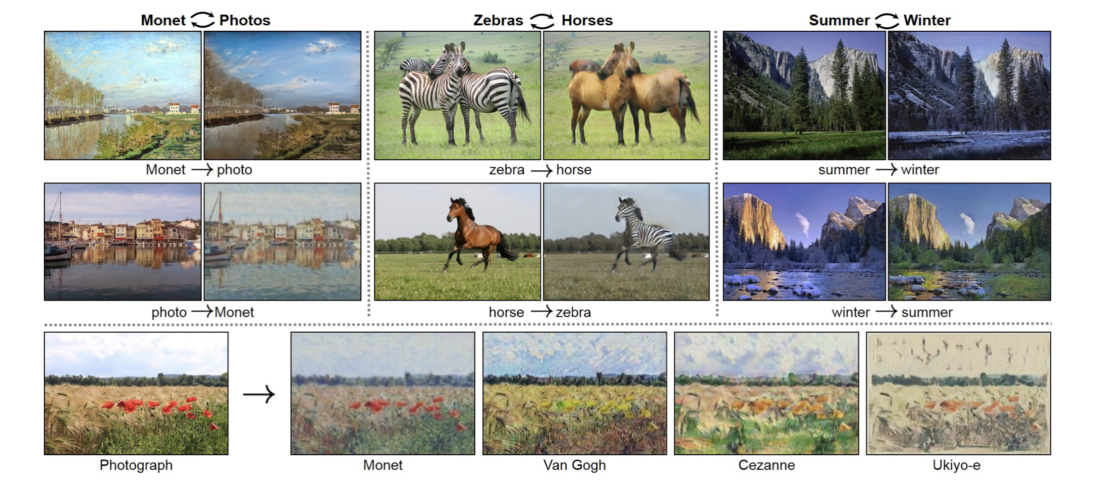
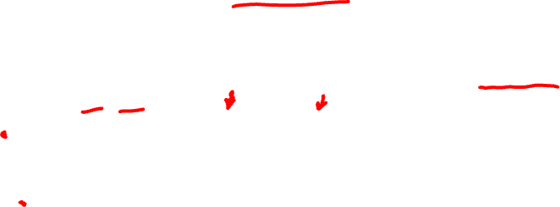
Cycle GAN
Alyosha Efros
Zhu et al., Unpaired Image-to-Image Translation using Cycle-Consistent Adversarial Networks, ICCV 2017

Slide 24
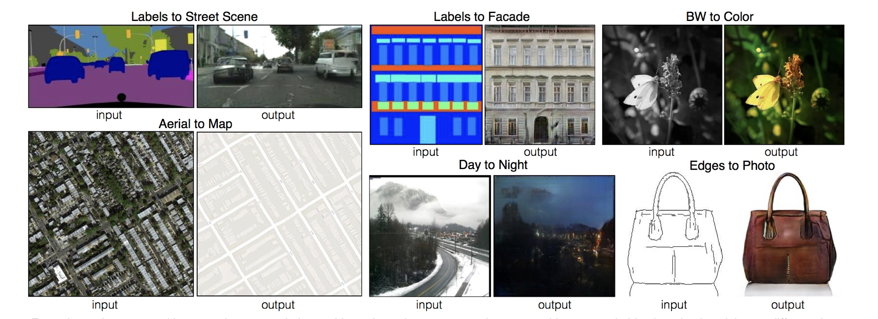
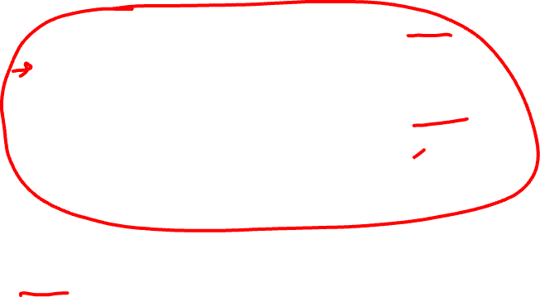
Pix2Pix
P. Isola et al. Image-to-Image Translation with Conditional Adversarial Nets, CVPR 2017

Slide 25
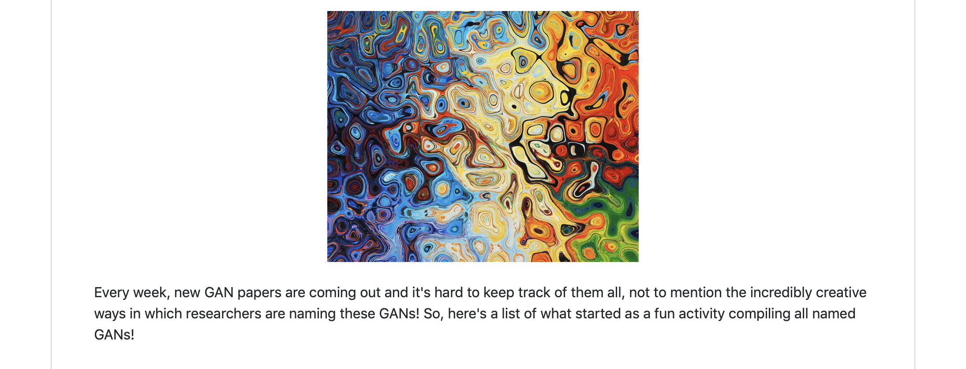
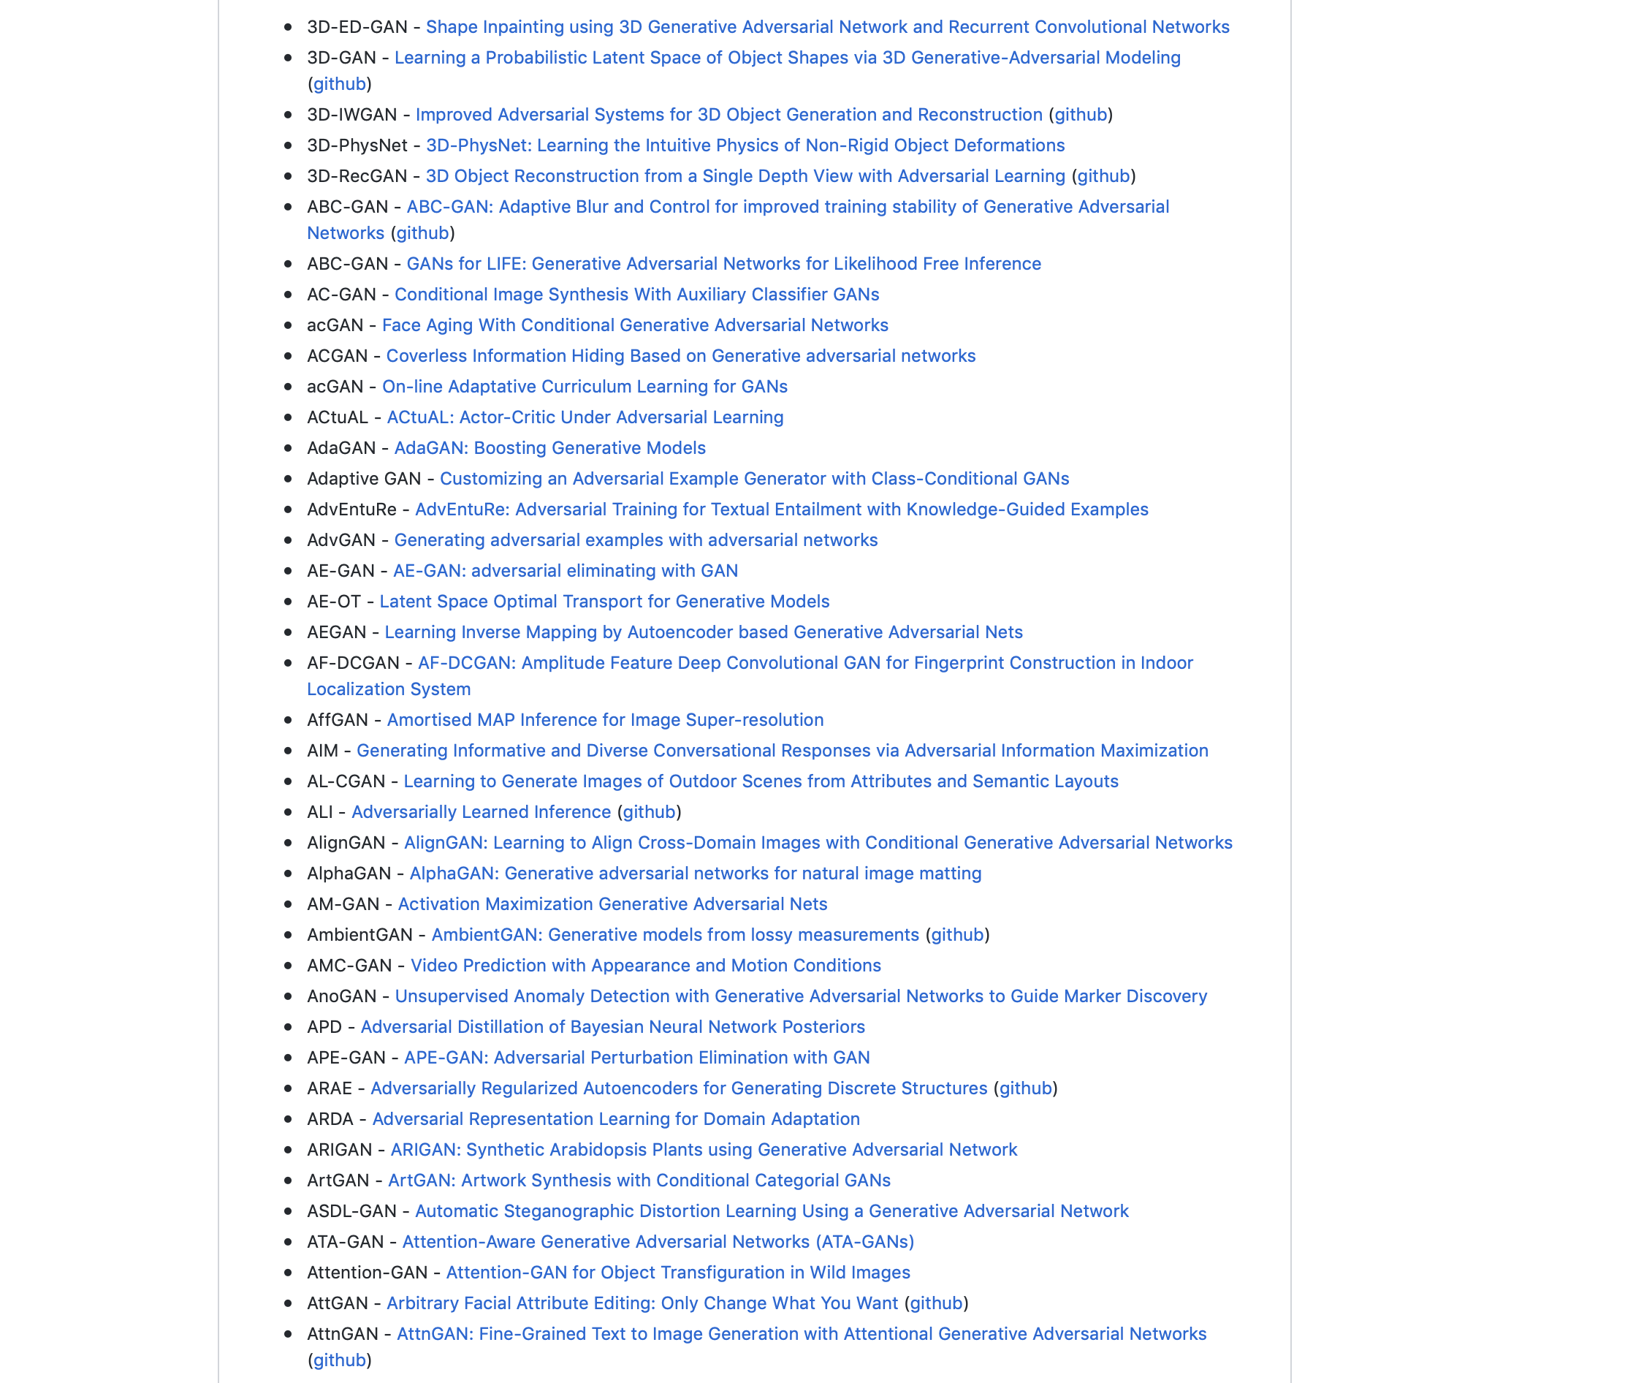
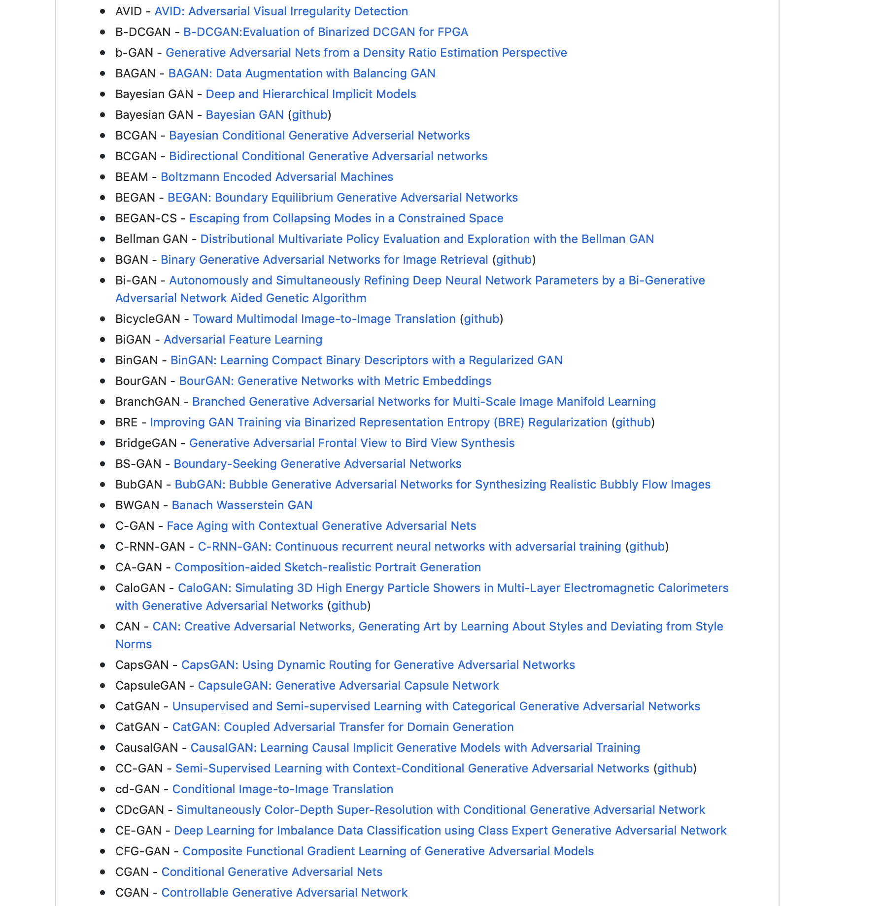

The Gan Zoo
…
https://github.com/hindupuravinash/the-gan-zoo

